Slide 1
An Algorithm for the Satisfiability Problem of Formulas in Conjunctive Normal Form
Rainer Schuler
Journal of Algorithms, Vol. 54, pp. 40-44, 2005
Date: June 28, 2005
Created by: Hsing-Yen Ann

Slide 2
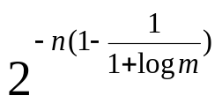
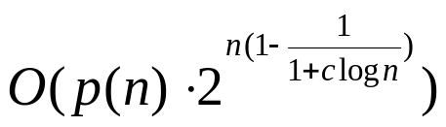
Abstract
We consider the satisfiability problem on Boolean formulas in conjunctive normal form. We show that a satisfying assignment of a formula can be found in polynomial time with a success
probability of , where n and m are the number of variables and the number of clauses of the formula, respectively. If the number of clauses of the formulas is bounded by n^{c} for some constant c, this gives an expected run time of
for a polynomial p.

Slide 3
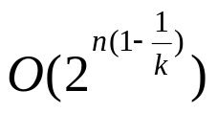


Problem Definition
The CNF-SAT problem is NP-complete.
The k-SAT problem is a special case of CNF-SAT, and is also NP-complete for k > 2.
Research goals:
Solve the problem exponentially faster than the 2^{n} time bound.
Previous result:
  k-SAT:
  CNF-SAT: for a constant

Slide 4
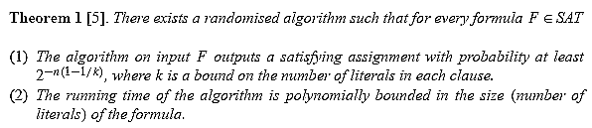
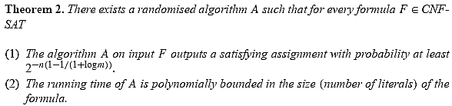
Some Theorems

Slide 5
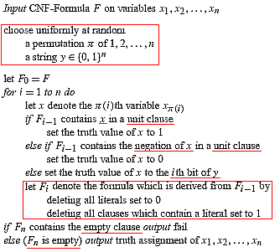
A Probabilistic Algorithm for k-SAT Problem
(PPZ-Algorithm)

Slide 6
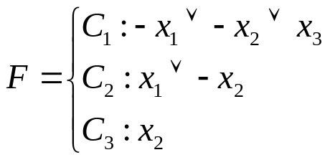
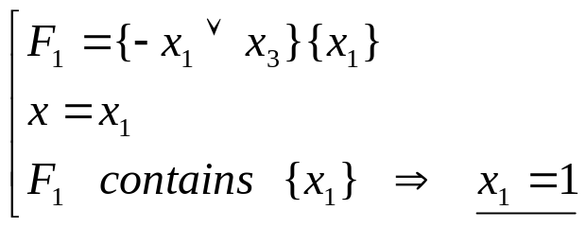
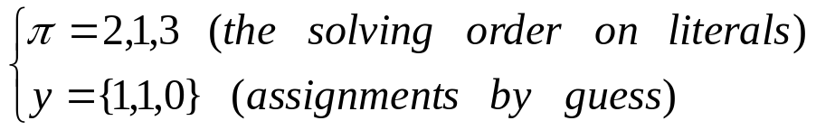
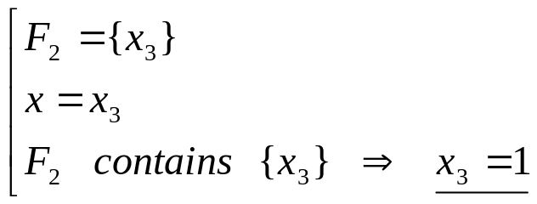
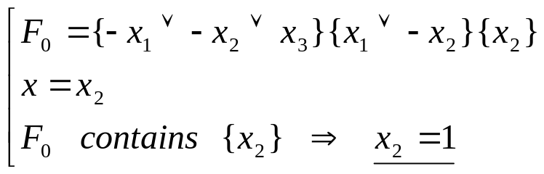
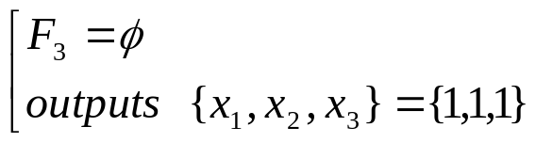
Example 1 for PPZ-Algorithm
(No Guess Used)
1
Input:
4
2
Randomly choose:
5
3
6

Slide 7
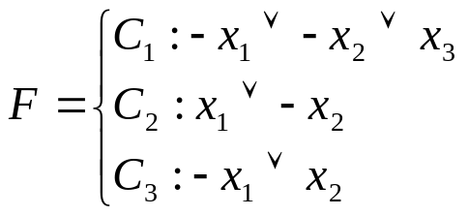
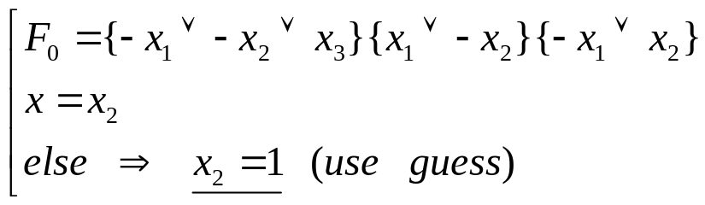
Example 2 for PPZ-Algorithm
(Guessing Correctly)
1
Input:
4
2
Randomly choose:
5
3
6

Slide 8
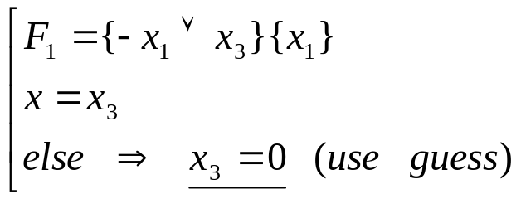
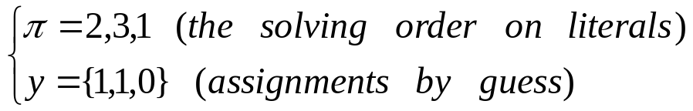
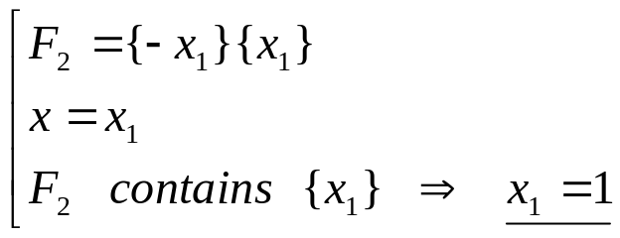
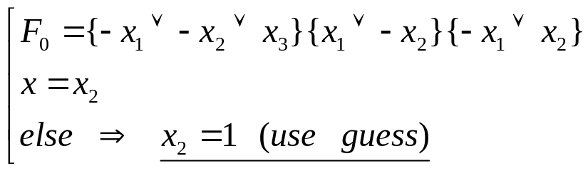
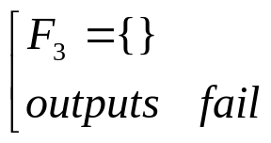
Example 3 for PPZ-Algorithm
(Guessing Error)
1
Input:
4
2
Randomly choose:
5
3
6

Slide 9
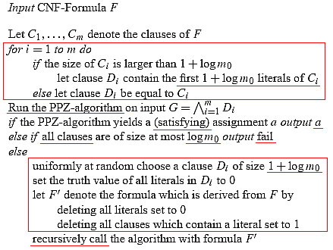
A Probabilistic Algorithm for CNF-SAT Problem

Slide 10
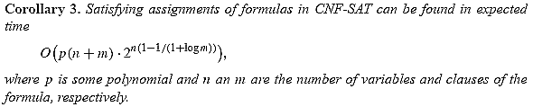

Some Corollaries

Slide 11


Open Questions
Can any deterministic algorithm achieve a similar time bound?
Whether the time bound could be improved to
for some constant .

